Slide 1
A click chemistry amplified nanopore assay for ultrasensitive quantification of HIV-1 p24 antigen in clinical samples
March 30, 2023
Chunlin Min
Wei, X., Wang, X., Zhang, Z. et al. A click chemistry amplified nanopore assay for ultrasensitive quantification of HIV-1 p24 antigen in clinical samples. Nat Commun 13, 6852 (2022). https://doi.org/10.1038/s41467-022-34273-x

Slide 2
Outline
Background
HIV
Click Chemistry
Nanopore
Paper
Opinions

Slide 3
Background

Slide 4
Human Immunodeficiency Virus (HIV)
HIV is a virus that attacks the body’s immune system. There is no cure, but treatments with antiretroviral therapy (ART) can stop further progression of HIV
HIV can be transmitted via bodily fluids
progression: Acute HIV -> chronic HIV -> AIDS
20% of new HIV infections are due to transmission from unaware infected individuals
Circulating RNA and antigen p24 are long recognized as significant biomarkers for HIV-1
Earlier studies suggest antigen p24 is a stronger predictor of progression to acquire AIDS than was RNA. However, proteins cannot be amplified like nucleic acid, which makes it challenging to achieve good sensitivity for p24 detection

Slide 5
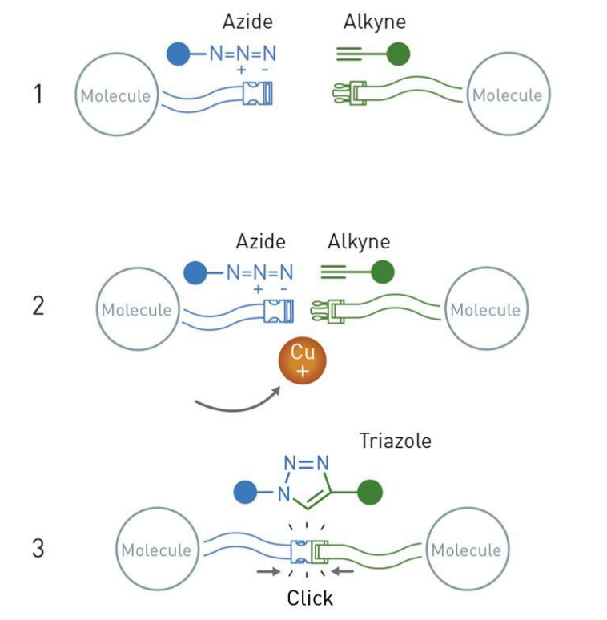
Click Chemistry
Convenient way of doing chemistry
Simple & no waste
Crown jewel of click chemistry: the copper catalyzed azide-alkyne cycloaddition
Widely utilized and reliable way of forming connections between different functional groups

Slide 6
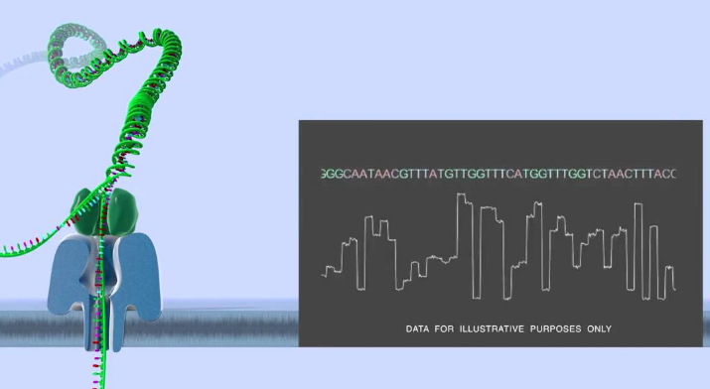
Nanopore
Literally a nano sized pore on a membrane
The pore and membrane can be biological, solid-state, or a hybrid complex of biological and solid-state
Principles
Apply a voltage across the membrane
Induced ion current is measured
Analyte passing through the pore causes current blockade (translocation event) and exhibits a unique signature
Analyte concentration correlate to frequency of translocation events
Challenges
Statistical in nature, requires at least nanomolar level of analyte concentration to operate practically
Direct application in complex clinical samples with interferent molecules

Slide 7
Paper

Slide 8
Motivations
Lower transmission rates for HIV and improve patient outcomes by extending detection window and monitoring capacity of HIV biomarker assays
Achieved through a lower limit of detection (LOD) and accurate quantification
Existing assays for HIV have either unsatisfactory sensitivity or has not made successful translation through clinical studies
PCR techniques for detecting circulating RNA is costly, time consuming, and does not have significant correlation with host immune parameters, such as infection-fighting CD4 cells, like p24 antigen does
This paper presents a nanopore assay amplified by click chemistry for detection of HIV-1 p24 antigen in clinical samples

Slide 9
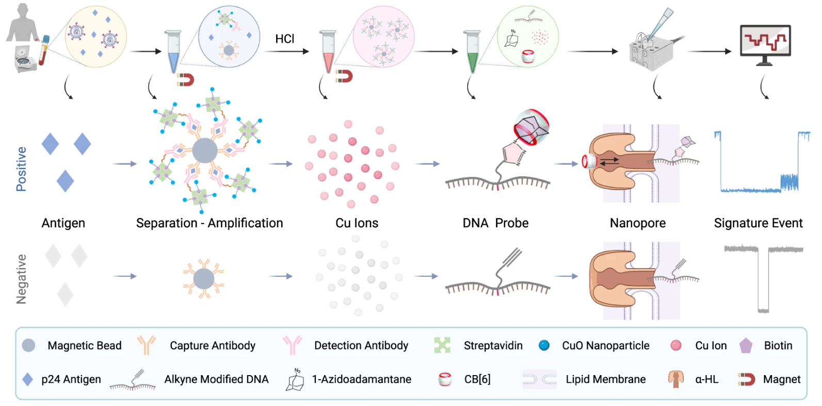
Click Chemistry Amplified Nanopore (CAN) Assay Workflow
Notes:
Here’s the overview of the assay workflow.
First, human serum samples were incubated with capture antibody-modified magnetic beads (MBs) and detection antibody-modified copper oxide nanoparticles (CuONPs) to form a sandwich structure.
Then, the sandwich complexes were magnetically separated, and copper ions were released under acidic conditions.
DNA probes were then formed, under click chemistry reaction catalyzed by the copper ions, followed by modification from host-guest interaction with CB[6].
Finally, the DNA probes were collected and sent to the nanopore system for measurements. The rate of the signature events are used to determine concentration of the analyte of interest.

Slide 10
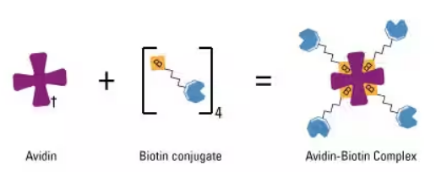
CAN Assay Overview
LOD of 20.8 fM (0.5 pg/mL) for p24 detection in human serum
40~100-fold higher analytical sensitivity than a fluorescent copper nanoclusters (CuNCs) assay
20-fold higher analytical sensitivity than a clinically used benchmark ELISA
Selectivity due to multi-level translocation signal that is clearly different from translocation signatures of other molecules
High sensitivity due to amplification by click chemistry & biotin-avidin binding

Slide 11
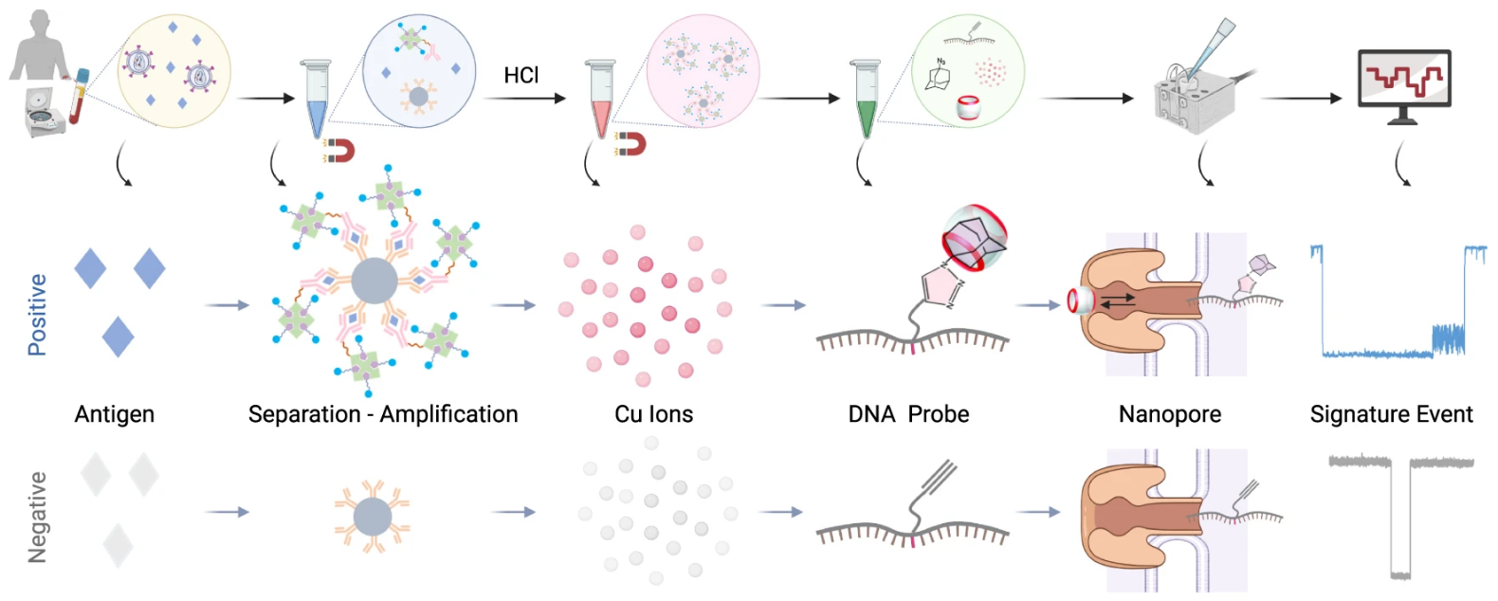
Paper Subtopics
Nanopore Characterization and Translocation Behaviors of DNA Probes
Cu+ Ion Concentration Dependent Catalytic Click Reaction
Optimization of the CAN Assay
Analytical Performance Benchmarking
CAN Assay Clinical Validation in a Pilot Cohort
Notes:
The following sections of the paper are organized in this order.
We will basically work our way backwards in the assay workflow diagram, starting with characterizing the nanopore system, followed by the copper ion catalyzed click reaction, and finally discuss the amplification step.
Last two sections are on comparisons to other sensing methods and clinical experiments.

Slide 12
Nanopore Characterization and Translocation Behaviors of DNA Probes

Slide 13
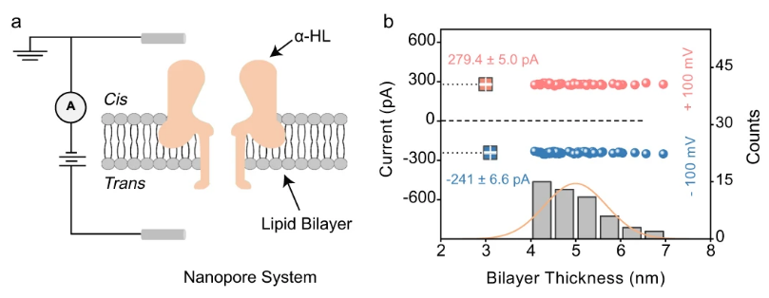
Nanopore Characterization
Ensure proper operations of the nanopore
Notes:
To ensure that the nanopore will operate properly, positive and negative voltages were applied to the trans side of open channel nanopore with cis side grounded.
A properly inserted α-HL pore is characterized by larger ionic current under a positive trans voltage than it is under a negative trans voltage. This is indeed observed in figure b.
Also, the suitable thickness of a bilayer membrane for insertion is ~5 nm, corresponding to 160-180 pF capacitance. Measurements show that thickness distribution roughly centers around 5nm.
Nanopore characterization shows the nanopore system is properly setup.

Slide 14
Translocation Behaviors of DNA Probes
Characterizing multiple phases of the DNA probe
alkyne modified DNA
Sequence: 5’-CCCCCCCCCCT*CCCCCCCCCC-3’, T* indicates alkyne-modified thymine
DNA-1-Azidoadamantane (DNA-AA)
Obtained via click reaction between alkyne modified DNA & 1-Azidoadamantane (AA) in presence of copper ion catalyst
DNA-AA@cucurbit[6]uril hydrate (DNA-AA@CB[6])
Obtaiend via host-guest reaction between DNA-AA and CB[6]
Notes:
Difference phases of the DNA probes were also characterized to understand the raw current measurements from the nanopore system.
We have first the alkyne modified DNA, purchased from vendor.
Then, through click reaction between alkyne and azide, DNA-Azide (DNA-AA) was formed (this process takes >4 hours)
Finally, DNA-AA is incubated with CB[6] to form DNA-AA@CB[6] complex (also takes >4 hours)
Note that in the workflow of the assay, DNA-AA formation is dependent on the analyte concentration responsible for producing the copper ions for the click reaction. So, these time-consuming steps are part of the whole assay procedure.

Slide 15
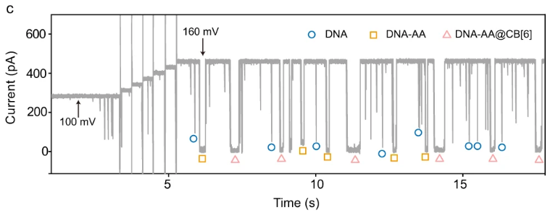
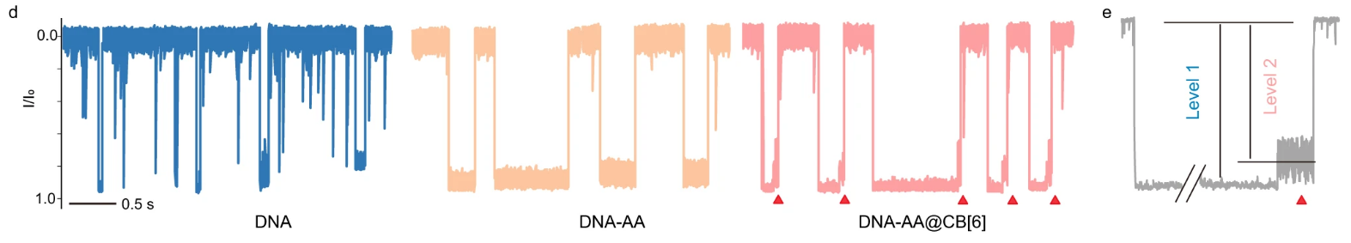
Translocation Behaviors of DNA Probes (Cont.)
Notes:
Figure c shows the raw current traces of the nanopore system. Different signatures of the DNA probes are marked.
Figure d shows the current traces for each phase of DNA probe in details. Each signature can be characterized by current magnitude and duration.
Difference in the characteristics between each phase of DNA probe is clearly seen.
For DNA-AA@CB[6] complex, there is a multi-level signature. This is seen more clearly in figure e. Level 1 signal is due to DNA backbone translocation, level 2 is due to CB[6] oscillation after dissociation. Multi-level signature ensures highly specific detection.

Slide 16
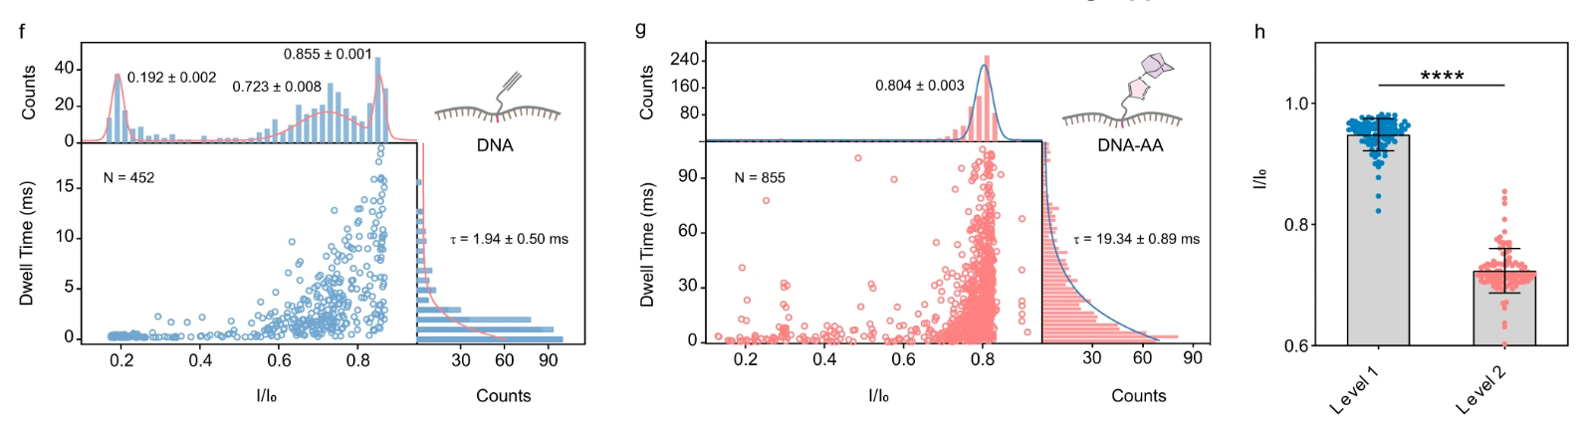
Quantitative Analysis of Translocation Events
Notes:
Quantitative analysis was done on translocation events for DNA and DNA-AA.
Graphs f and g are 2 dimensional graphs showing current blockage and dwell time profile. Dwell time is basically how long a molecule interacts with or blocks the nanopore.
You can see that in figure f for DNA, current blockade centers around 0.855. The other peaks, explained by the authors, may be due to background noise and random DNA collision with the nanopore.
Figure g for DNA-AA has similar blockage profile, but without non-specific peaks. However, mean dwell time for DNA-AA significantly increased.
DNA-AA@CB[6] complex did not further change the current blockade and dwell time profile, but this structure does cause a two-level translocation signal as discussed previously. This is quantified in figure h, where the authors performed a statistical test call unpaired two-samples t-test, which tests if the means of samples are the same. The test found that p < 0.0001, which suggests the difference in dwell time mean is likely not due to chance. In other words, there is significant difference in the mean current blockade between level 1 and level 2 signals.

Slide 17
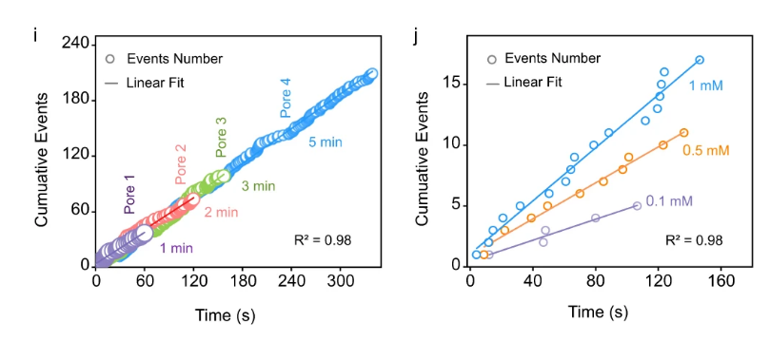
Capture Rate Study on DNA-AA@CB[6]
Notes:
Capture rate study was done on the translocation events induced by DNA-AA@CB[6]
This kind of study helps us to understand how the signal of interest varies based on various parameters such as capture time, operating voltage, and copper ion concentrations.
It also tells us how much variations exist across different nanopores.
Figure i shows the cumulative capture events over different recording times and across four different nanopores. Clearly, we can see a consistent slope, or capture rate, across all the measurements.
Similarly in figure j, we have the cumulative events over time for various copper ion concentrations. You see a positive correlation with the copper ion concentration here because they are responsible for creating DNA-AA@CB[6], so more copper ions causes more DNA-AA@CB[6] to be formed.

Slide 18
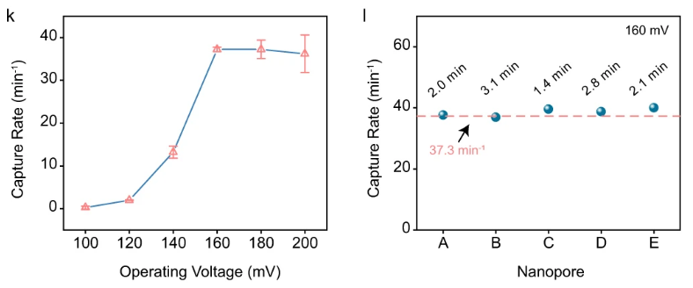
Capture Rate Study (Cont.)
Notes:
Figure k shows the capture rate as operating voltage is varied.
Capture rate increases with operating voltage. This is because higher positive voltage promotes dissociation of CB[6] from the DNA linked complex and reduces the possibility of DNA escaping back to the cis side of the nanopore membrane.
However, high voltage can also destabilize the membrane, which explains the increased variations at high operating voltages.
Based on the capture rate studies, the authors picked the optimal parameters of 160 mV and 2-minute recording time.
Figure l shows experiments done under optimal parameters. This is just to highlight consistency of detection.
--------------------------------------------------
Capture rate also depends on electrochemical environment of the nanopore system.
Optimal multi-level signal frequency can only be achieved using balanced cis and trans work solutions.
In other words, same electrolyte concentrations and pH levels on both cis and trans side

Slide 19
Cu+ Ion Concentration Dependent Catalytic Click Reaction

Slide 20
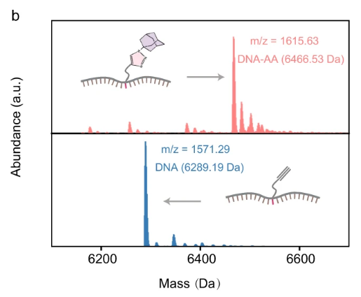
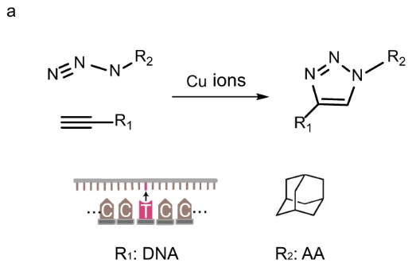
Cu+ Ion Concentration Dependent Catalytic Click Reaction
Study the impact of Cu+ ion concentration and reaction time on the click reaction between azide and alkyne (DNA => DNA-AA)
Notes:
Now we will take a look at the click reaction in the assay workflow.
This click reaction is shown in figure a between alkyne and azide to connect the DNA with adamantane.
Figure b shows the mass spectrometry of the DNA probe before and after the click reaction.
It is important to notice that the peak in the mass spectrum shifts right for the product of the reaction.

Slide 21
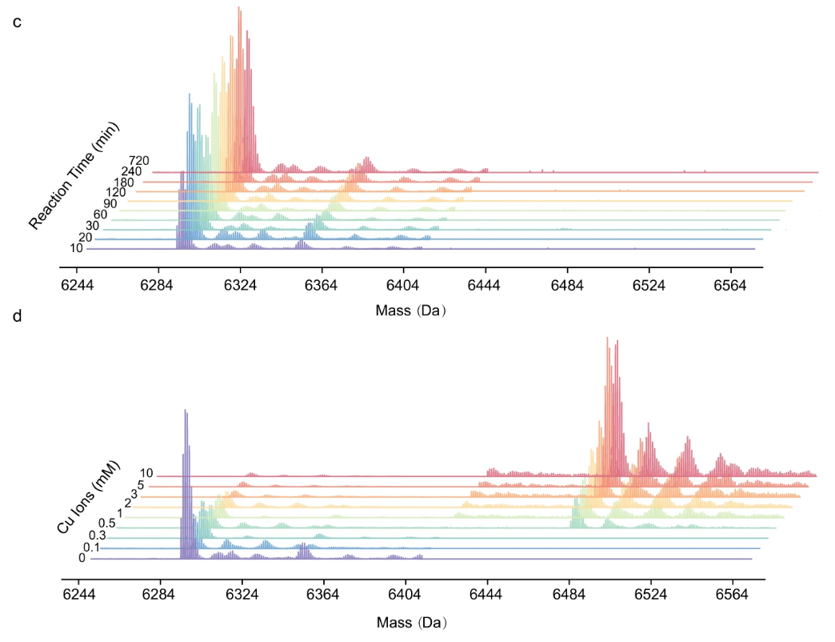
Mass Spectrometry Measurements of Click Reaction
Notes:
Figure c shows mass spectrometry measurements of click reaction under zero copper ion concentration. We can see that the peaks in the spectrum does not shift at all. In other words, no products are formed, meaning that click reaction does not proceed in the absence of copper ion catalyst.
In the presence of copper ions however, the click reaction does move forward. This is seen in figure d. A higher concentration of copper ions causes more products to be formed.

Slide 22
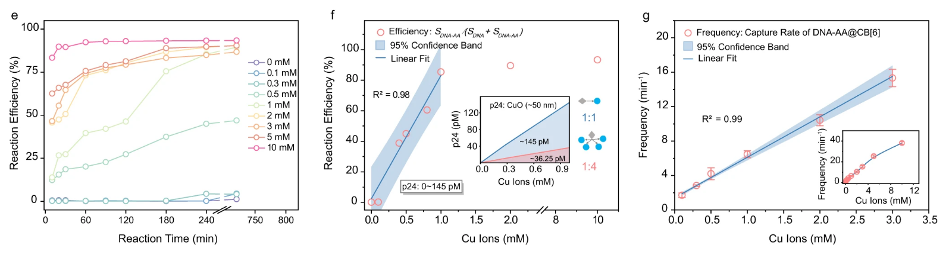
Reaction Efficiency and Relations to Capture Rate
Notes:
Now to understand

Slide 23
Optimization of the CAN Assay

Slide 25
Analytical Performance Benchmarking

Slide 27
CAN Assay Clinical Validation in a Pilot Cohort

Slide 29
Opinions

Slide 30
Opinions?
Paper is heavy on characterization studies
Graphs are properly labeled, easy to interpret, coloring is generally consistent
Detection mechanism diagram shows both positive and negative detection scenarios
The only novelty is in the copper ion delivery system where each captured analyte yield 4 copper ions instead of 1
Nothing said about significance of DNA sequence used or why the linking happens at middle position of sequence
Not sure how specificity is calculated in Fig 5.c
Would like to see a diagram of the nanopore assay
Unclear if assay uses single nanopore or a matrix of nanopores for detection
Very important to reduce time and cost of assay

Slide 31
References

